Slide 1
A Good Paper for
Applied Thermal Engineering
Prof. David Reay,
Editor-in-Chief
Heriot-Watt, Newcastle, Northumbria & Nottingham University;
David Reay & Associates

Slide 2
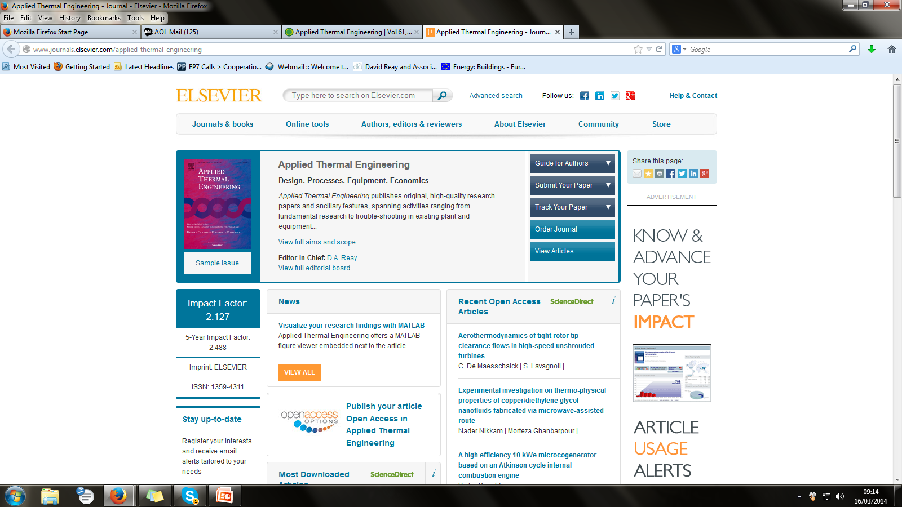
The Journal URL and Home Page www.elsevier.com/locate/apthermeng

Slide 3
What an Editor Sees:
View Submission
View CrossCheck Report
Details
History
File Inventory
Edit Submission
Classifications
Assign Editor
Invite Reviewers
View Reviews and Comments
Similar Articles in MEDLINE
Scopus Author Search
CrossRef Title Search
Submit Editor's Decision and Comments
Send E-mail
Linked Submissions

Slide 4
Journal History
First Issue in 1981 – then called ‘Heat Recovery Systems’ 4 issues/year – under the Pergamon Press imprint
Changed its name to ‘Heat Recovery Systems & CHP’ to reflect widening scope
Then, under Elsevier, to ‘Applied Thermal Engineering’ (ATE)
So far 10 issues have appeared or are in preparation for 2014
Current Impact Factor 2.127

Slide 5
Organisation
Keith Lambert is Publisher, Mechanical Engineering, for Elsevier (ATE falls within the Mechanical Engineering portfolio)
David Reay is Editor-in-Chief of ATE
Supported by Regional Editors in Europe, USA, India & China
Who all have Associate Regional Editors to assist – e.g. In Mexico, Malaysia, China, Japan, and Hungary.

Slide 6
Paper Processing - 1
Elsevier carries out screening for language/layout etc. Paper may be returned to author for modifications
Then it is (via EES) passed to the Editor-in-Chief, who makes a decision:
  Reject (on scientific or journal compatibility grounds)
  Reject outright (e.g. suggest sending it elsewhere)
  Forward to a Regional Editor

Slide 7
Paper Processing - 2
The Regional Editor either allocates an Associate Editor to process the paper, or does it himself.
  Select reviewers (typically 3) – Authors are invited to nominate three independent expert reviewers
  Send to reviewers
  Await comments/chase reviewers
  Send comments to author asking for a revision to be submitted or the paper may be rejected at this stage
  If a revision submitted, it is sent for reviewing again
  If, on return, acceptance is recommended, the paper goes to Elsevier for proofing

Slide 8
Choose the Journal Carefully-1
Look at the Journal Title:
  Pure science
  Applied science
  Applied engineering
  Areas of these (heat transfer, fluids etc.)
‘Applied Thermal Engineering’ – means:
  Applied technologies
  Those with a thermal content (not necessarily 100%)
  Related to engineering
READ the Aims and Scope

Slide 9
Choose the Journal Carefully-2
But there are many steps between basic research and the application of a concept
  An intention to ‘apply’ the research can be sufficient
  Fundamental thermal research of generic interest to engineering is of interest
Editors can redirect papers that may be ‘out of scope’ to other journals
  Int. J. Heat & Mass Transfer, Combustion & Flame, Solar Energy, Int. J. Thermal Sciences, Int. J. of Exergy are some to which we commonly redirect papers.

Slide 10
Conference Papers
In most cases conference submissions do not make good journal papers without substantial changes:
  Conference papers are often limited in length & hence detailed content
  They lack good reviews of previous work/relevant literature
  The research reported may be at an early stage – too early for archival journals
  The innovative aspects may be lacking
  They are probably written for a narrower audience
  Peer reviewing is probably less rigorous

Slide 11
Special Issues
But: ATE publishes ‘Special Issues’ that are compilations of conference papers selected by Guest Editors.
  The selected conference papers are extended and peer-reviewed to a higher standard (generally).
  Guest Editors prepare an Editorial relating the papers to the conference theme(s)
  The authors, of course, get a citation that carries more weight than a conference paper (which may have limited distribution/accessibility)

Slide 12
Review Papers
Review Papers are normally invited by the Editors
OR an author may submit the idea of a review to an Editor and await a decision on its relevance, scope and the author’s expertise in the area.
Many reviews are well-cited – in the top 25 ATE cited papers probably 10 or more are review papers.
They can be longer than Research papers.

Slide 13
A ‘Good’ Paper for ATE
The Paper Title
  Very important – attracts the potential reader’s attention and may be used in search engines
  Do not use acronyms (remember the papers are read world-wide and some acronyms may be unfamiliar in some countries)
  One simple example – PI can be process integration (most common) or process intensification (less common)
  Title should be not too long but should cover the main topic

Slide 14
Keywords
Again useful for search engines, but it also helps the Editor find reviewers from his/her database
5 or 6 is more than adequate
Start with the main theme
E.g. Geothermal energy; energy recovery; electricity generation; Kalina cycle. For a paper on the topic of: ‘Recovery of energy from geothermal wells for electricity generation, based upon the Kalina cycle’

Slide 15
Graphical Abstract and Highlights
Experimental study on an inverter heat pump with HFC125 operating near the refrigerant critical point
Pages 1-7
Fang Wang, Fengkun Wang, Xiaowei Fan, Zhiwei Lian
Show preview | PDF (1252 K) | Related articles | Related reference work articles
Graphical abstract (Here the author may show a graph or other illustration covering an important outcome)
Highlights
► An inverter heat pump with HFC125 operating near the refrigerant critical point. ► The COP and exergy efficiency varied with outlet temperatures of heat sink. ► The exergy defect in each component was performed. ► A maximum exergy efficiency was obtained around 65 °C of hot water temperature

Slide 16
The Main Paper Sections - 1
Abstract
(Contents List – can be useful for extended Review Papers)
Nomenclature – (Alphabetical + Greek + sub/superscripts + acronyms etc.)
Introduction
Main text (theory, experiments etc.)
Discussion of results
Conclusions
Acknowledgements
References
(Appendices)
Tables & Figures

Slide 17
The Main Paper Sections - 2
Journals do indicate in the ‘Instructions to Authors’ the appropriate length of papers – these tend to be guidelines.
ATE has:
  Short communication/technical note – up to 1500 words + 4 figures/tables
  Research paper – 4000 words + 12 figures/tables
  Review articles – 5000 words (to be increased)
The word count excludes the abstract, nomenclature, references and is a guideline.

Slide 18
The Main Paper Sections - 2
It is helpful to editors and reviewers if pages are numbered
It is also useful to give each text line a number – this aids reviewers in highlighting where their comments apply.

Slide 19
The Abstract
Typically 200 words
It states not just what you have done, but the principal outputs of the work.
Ideally there will be quantified data
It is a ‘stand alone’ item so should be written to attract the reader’s attention – it may be the only part he has access to in data searches.

Slide 20
The Introduction
As well as introducing your work, it should include a review of relevant literature and previous research in the field.
Conclude with a summary of what you are proposing to report on, highlighting how it moves on from earlier work.
The Introduction may contain most of the references you cite in your paper, if the review is extensive.

Slide 21
The Introduction - 2
When using multiple references e.g. (2), (3) (7) 10) … briefly describe features of EACH reference rather than just giving an overview of what is included.

Slide 22
Main Text
May be sub-divided into numbered sections/subsections
Experimental data should be backed up by error analyses/instrumentation accuracies etc. Data on the test facility – a photo of it helps (cases where no rig existed!)
Heavy theory can be relegated to an Appendix

Slide 23
Discussion of Results
An analysis of your experimental/theoretical data.
Highlight important outcomes and also areas where you feel further research may be warranted.
Be objective in your analysis – you are a scientist/engineer, after all!

Slide 24
Conclusions
Be brief
Do not repeat whole paragraphs from the Discussion of Results
You may use bullet points
Do not cite references or figures in the Conclusions
Make sure results mentioned here are consistent with those in the Abstract.

Slide 25
Acknowledgements
Supporting bodies (EPSRC & Contract number); companies funding the R&D; colleagues who helped significantly (but are not co-authors)
Brief if possible.
Acknowledge material taken from other workers/publications where you have sought permission.
ATE does not carry pen portraits of the authors, unlike some journals.

Slide 26
Figures & Tables
Tables headings go ABOVE Tables. Check any symbols/acronyms used are listed earlier.
Figures numbered sequentially. May be submitted as separate files or in the text as a single document. Titles go BELOW figures.
Read journal guidelines regarding number of each allowed (if limited)
Check for legibility at the size they are likely to appear in the printed version of ATE (which is also not in colour unless specifically requested and paid for by the author)

Slide 27
Videos & Webcasts
You can now add videos to a paper and these will appear in on-line versions.
For example, boiling phenomena in narrow channels, some CFD simulations, etc.
http://www.elsevier.com/audioslides
Allows you to add a Webcast explaining aspects of your research – a sales pitch!

Slide 28
References
Standard format for these – see journal home pages
If you cite a web site, give the date when accessed
A normal research paper may have 20-30 references, a review 70-100 references.

Slide 29
Finally: A Reminder of the Journal Web Site
www.elsevier.com/locate/apthermeng

